Slide 1
Deep Learning
Generated for: RNNs, Deep Learning
Notes:
Welcome to the Deep Learning presentation covering multiple topics. Today we'll explore: RNNs, Deep Learning.

Slide 2
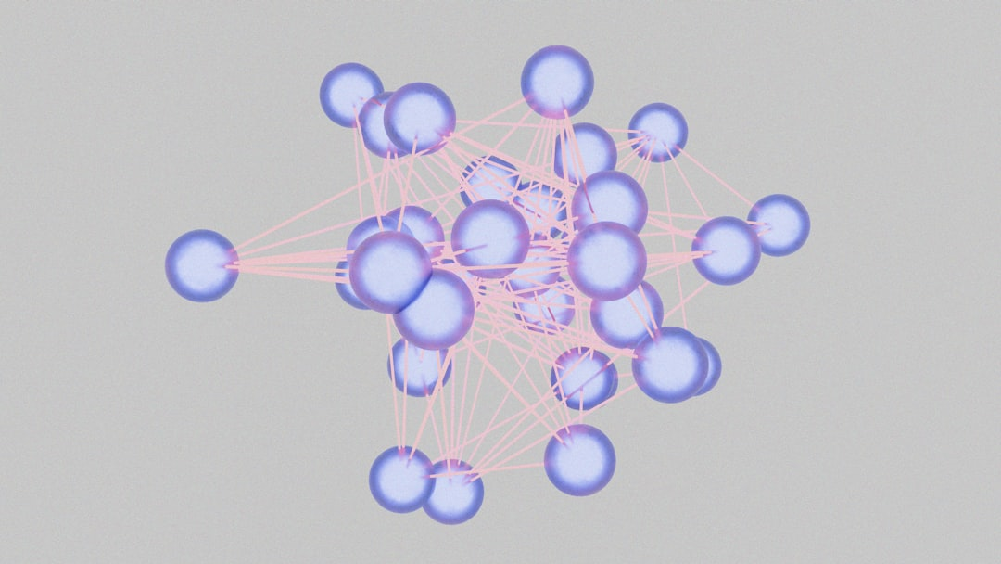
RNNs - Introduction
Recurrent Neural Networks process sequential data
RNNs have feedback connections for temporal relationships
Used for speech recognition and natural language
RNNs learn patterns in time-series data effectively
Simple RNNs have limitations due to vanishing gradients
Long Short-Term Memory networks address this issue
RNNs are useful for machine translation tasks also
Can be applied to music and text generation too
Basic RNN architecture includes input and output
Activation functions like sigmoid are commonly used
Notes:
When introducing RNNs, emphasize their ability to handle sequential data, a key aspect of many real-world applications such as speech recognition and natural language processing. Explain how RNNs learn patterns over time and mention their limitations, such as the vanishing gradient problem. Introduce Long Short-Term Memory networks as a solution to this problem. Provide examples of RNN applications, including machine translation, music generation, and text generation. Ask students to consider how RNNs could be applied to other sequential data problems. Key takeaways should include the basic architecture of RNNs and their potential applications.

Slide 3

RNNs - Introduction
Recurrent Neural Networks (RNNs) process sequential data
RNNs have feedback connections, allowing information recall
Temporal relationships are modeled using RNNs
Vanilla RNNs are basic, with simple recurrent connections
RNNs are used in natural language processing (NLP) tasks
Speech recognition, language modeling, and text classification
RNNs can learn long-term dependencies in data sequences
Backpropagation through time (BPTT) is used for training
RNNs can be trained using stochastic gradient descent (SGD)
RNNs architecture: input, hidden, output layers
Notes:
When introducing RNNs, explain the concept of sequential data and how RNNs are designed to handle it. Provide examples of NLP tasks, such as language translation or text summarization. Emphasize the importance of feedback connections in RNNs, allowing the network to recall previous information. Discuss the challenges of training RNNs, including the vanishing gradient problem, and how techniques like BPTT and SGD can be used to address these issues. Ask students to consider how RNNs can be applied to real-world problems, such as speech recognition or sentiment analysis. Key takeaways include understanding the basic architecture of RNNs and their applications in NLP tasks.

Slide 4
RNNs - Introduction
Recurrent Neural Networks process sequential data
Use feedback connections to capture temporal relationships
Suitable for speech, text, and time series data
Can learn long-term dependencies and patterns
RNNs have input, output, and hidden layers
Hidden state captures information from previous steps
Backpropagation used for training RNNs
Vanishing gradients affect RNN training
Simple RNNs are basic form of recurrent networks
Notes:
When introducing RNNs, emphasize their ability to handle sequential data and capture temporal relationships. Provide examples such as speech recognition, language modeling, and time series forecasting. Explain the basic architecture of RNNs, including input, output, and hidden layers. Discuss the challenges of training RNNs, including vanishing gradients. Ask students to consider how RNNs can be applied to real-world problems, such as predicting stock prices or generating text. Key takeaways include understanding the fundamentals of RNNs and their applications in deep learning.

Slide 5
Deep Learning - Introduction
Deep learning is a subset of machine learning methods
Inspired by the structure and function of the brain
Uses artificial neural networks to analyze data
Can learn from large amounts of data automatically
Enables computers to perform complex tasks
Such as image recognition and natural language processing
Requires significant computational power and resources
Has many applications in industries like healthcare and finance
Can be used for predictive modeling and decision-making
Continuously evolving with new techniques and architectures
Notes:
When introducing deep learning, explain that it's a type of machine learning that's inspired by the brain's structure and function. Give examples of how deep learning is used in real-world applications, such as self-driving cars and speech recognition systems. Ask students what they think are the benefits and limitations of deep learning. Key takeaways include understanding the basics of deep learning and its potential applications. Provide a simple example, such as image classification, to illustrate how deep learning works. Emphasize the importance of computational power and large datasets in deep learning.

Slide 6
Deep Learning - Introduction
Deep learning is a subset of machine learning techniques
Inspired by the structure and function of the brain
Uses artificial neural networks to analyze data
Can learn from large amounts of data automatically
Enables computers to perform complex tasks
Such as image recognition and natural language processing
Requires significant computational power and data
Has many applications in industry and research
Includes techniques like convolutional neural networks
Used in self-driving cars and speech recognition systems
Notes:
When introducing deep learning, explain that it's a key area of machine learning that leverages neural networks to analyze complex data. Provide examples of its applications, such as self-driving cars and speech recognition systems. Discuss the importance of computational power and large datasets in training deep learning models. Ask students to consider the potential benefits and challenges of deep learning in various industries. Key takeaways should include understanding the basics of deep learning and its potential to drive innovation in many fields.

Slide 7
Deep Learning - Fundamentals
Deep learning is a subset of machine learning methods
Inspired by the structure and function of the brain
Uses artificial neural networks with multiple layers
Can learn from large amounts of data automatically
Requires significant computational resources and time
Key applications include image recognition and speech
Natural language processing is also a major area
Deep learning models can be supervised or unsupervised
Common architectures include CNN and RNN models
y = σ(Wx + b) is a basic neural network equation
Notes:
When discussing the fundamentals of deep learning, emphasize the inspiration from the brain's structure and function. Explain how deep learning differs from traditional machine learning, highlighting its ability to learn from large datasets. Provide examples of key applications such as image recognition, speech recognition, and natural language processing. Mention the difference between supervised and unsupervised learning and briefly introduce common architectures like CNN and RNN. Use the equation y = σ(Wx + b) to illustrate a basic neural network operation, and ask students to consider how these elements come together in a deep learning model. Key takeaways should include understanding the basics of deep learning, its applications, and the importance of computational resources.

